Slide 1


Software Engineering Project 4th Presentation
Tom Leonard and Lucas Villiere

Slide 2


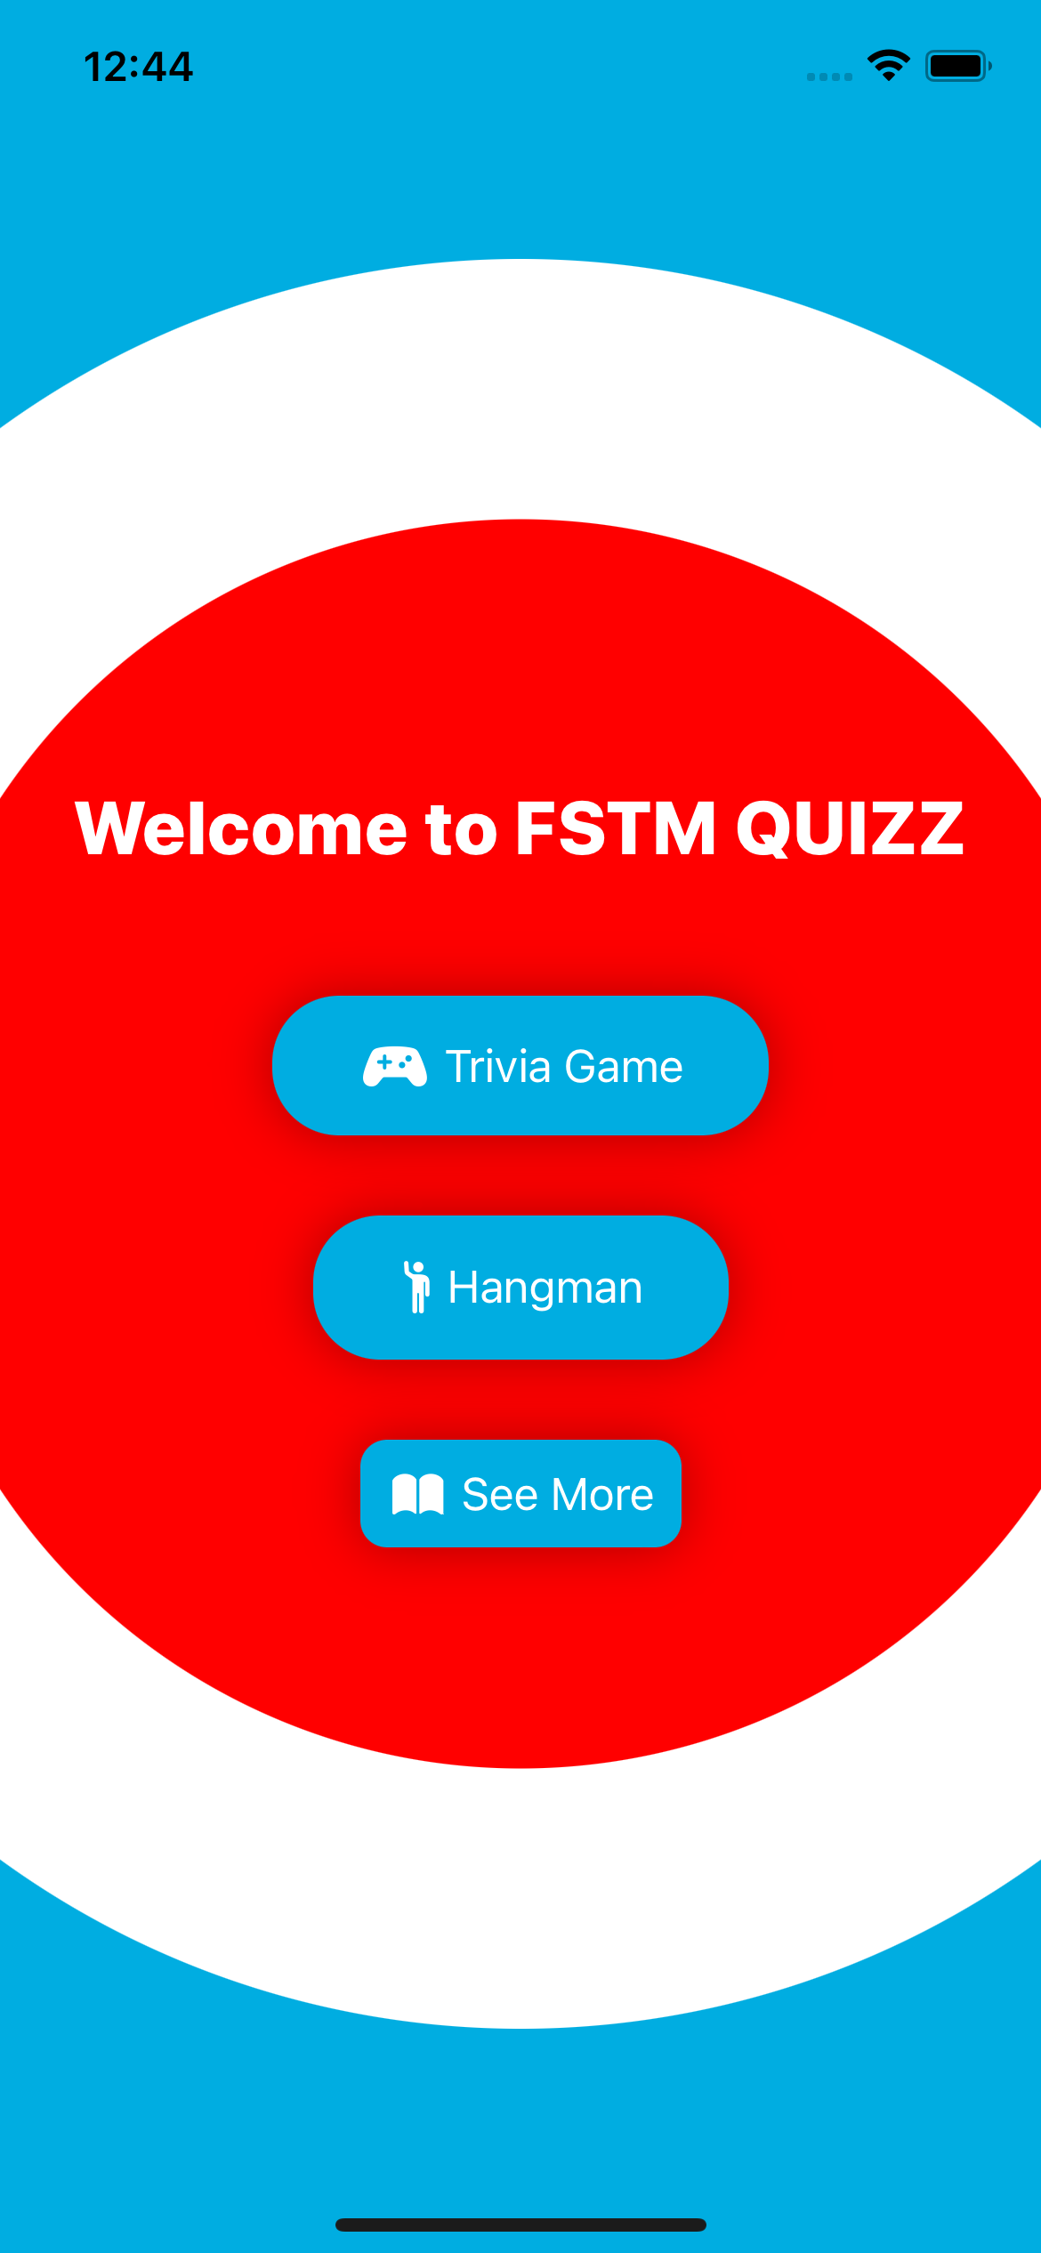
What was achieved in the second sprint ?
We have now a nice-looking menu with 3 buttons :
The first one allows to play the game.
The second one allows to play our new game : The Hangman !
The third one allows to see more about the social media of the university and us ! (see more next slide)

Slide 3
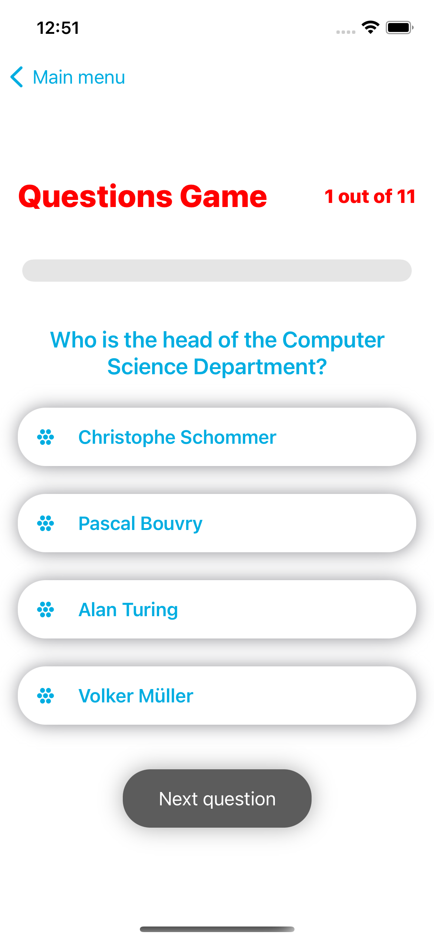
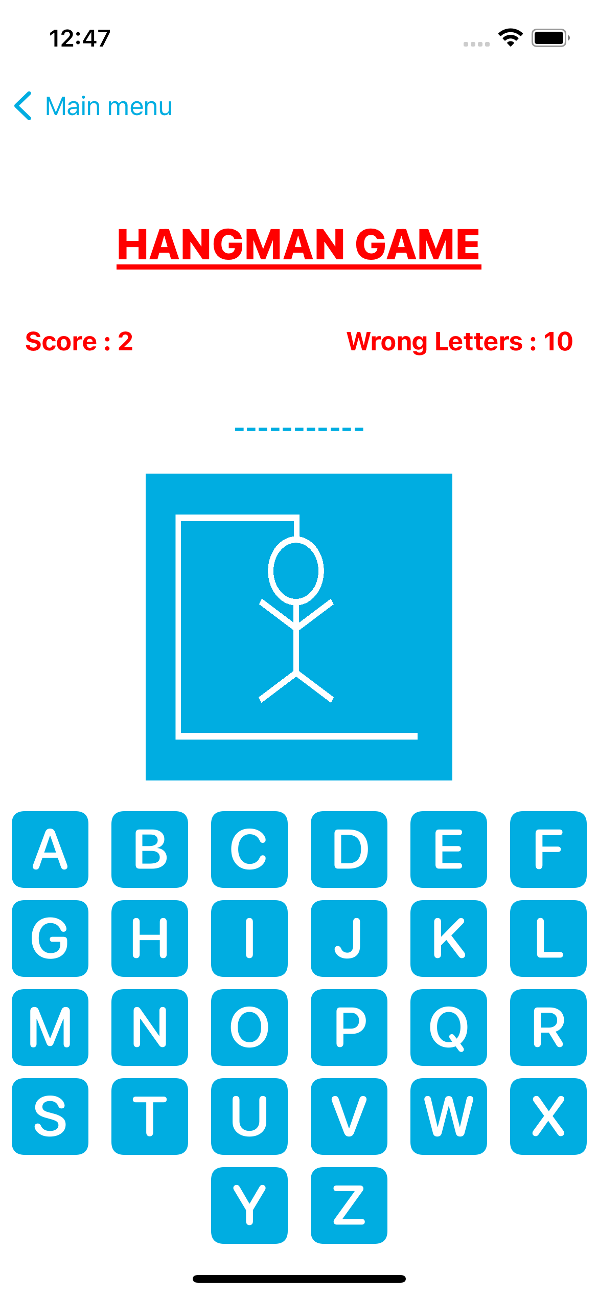
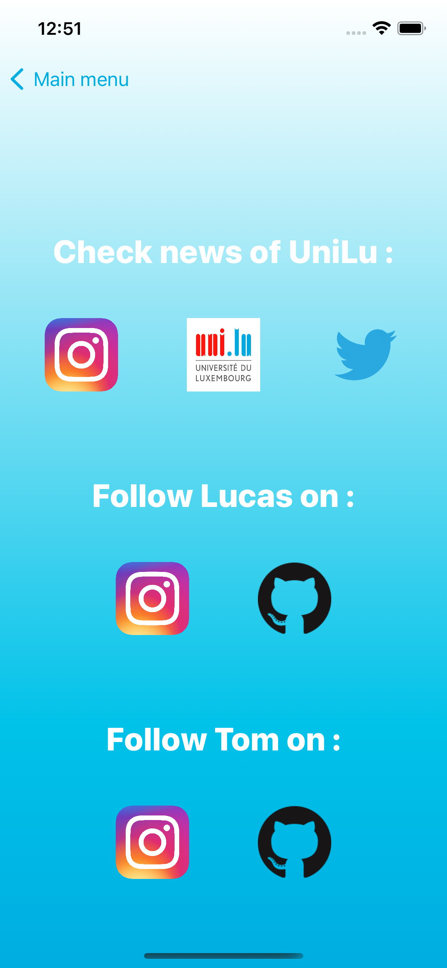

Slide 4
What was achieved in the second sprint ?
We created new questions for the trivia game.
We created a new game : The Hangman.
We fixed some bugs (double tap issue)

Slide 5
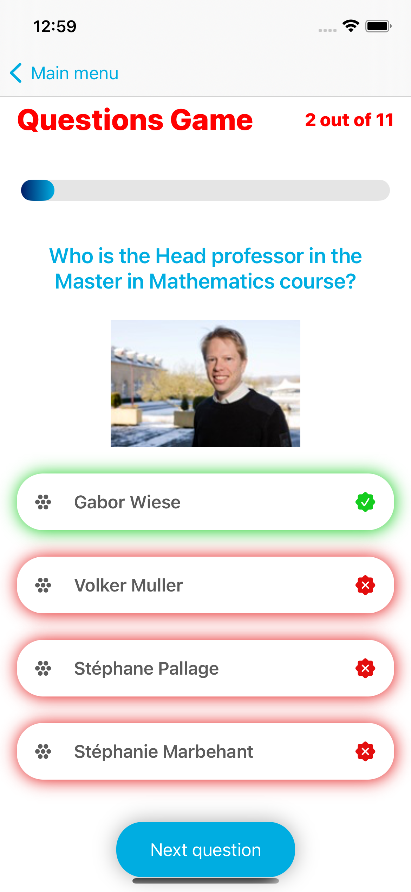
Here is an example of what’s new in the trivia game.

Slide 6
What is planned for the end ?
Create more questions for the main game.
Make the looking of the game better and some bug correction.

Slide 7
Any questions ?

